Slide 1
TEACHER CUE
CFU
HINT
Scaffolding for students
MAKE THE CONNECTION
Allow students to make the connection

Slide 2
Meiosis produces ________ daughter cells
Mitosis produces ________ daughter cells.

Slide 3
______________ cells have 2 chromosomes in each daughter cell.
______________ cells have 1 chromosome in each daughter cell.

Slide 4
___________ produces two identical copies (to the parent cell).
___________ produces two different copies (to the parent cell).

Slide 5
______________ happens in any non sex cell.
___________ happens only in sex cells.

Slide 6
A ______________ gene is the more powerful one that overrides the effect of the other
A _______________ gene is the weaker gene that is often overpowered

Slide 7
An allele is _______________________.

Slide 8
Heterozygous means ____________________.
Homozygous means ________________________

Slide 9
TT is _____________ __________
Tt is _________________
tt is _____________ _________

Slide 10
Genotype is __________________________________________________________________________
Phenotype is _____________________ _____________________________________

Slide 11
We are learning about how pedigree charts represent sex linked traits
TRACK WITH ME
READ WITH ME
I can read pedigree charts to identify affected individuals
I can use punnett squares to predict X linked inheritance

Slide 12
MAKE THE CONNECTION

Slide 13
MAKE THE CONNECTION

Slide 14
We are learning about how pedigree charts represent sex linked traits
A diagram that shows a family’s relationships and how characteristics are passed on from one generation to the next is a pedigree chart.

Slide 15
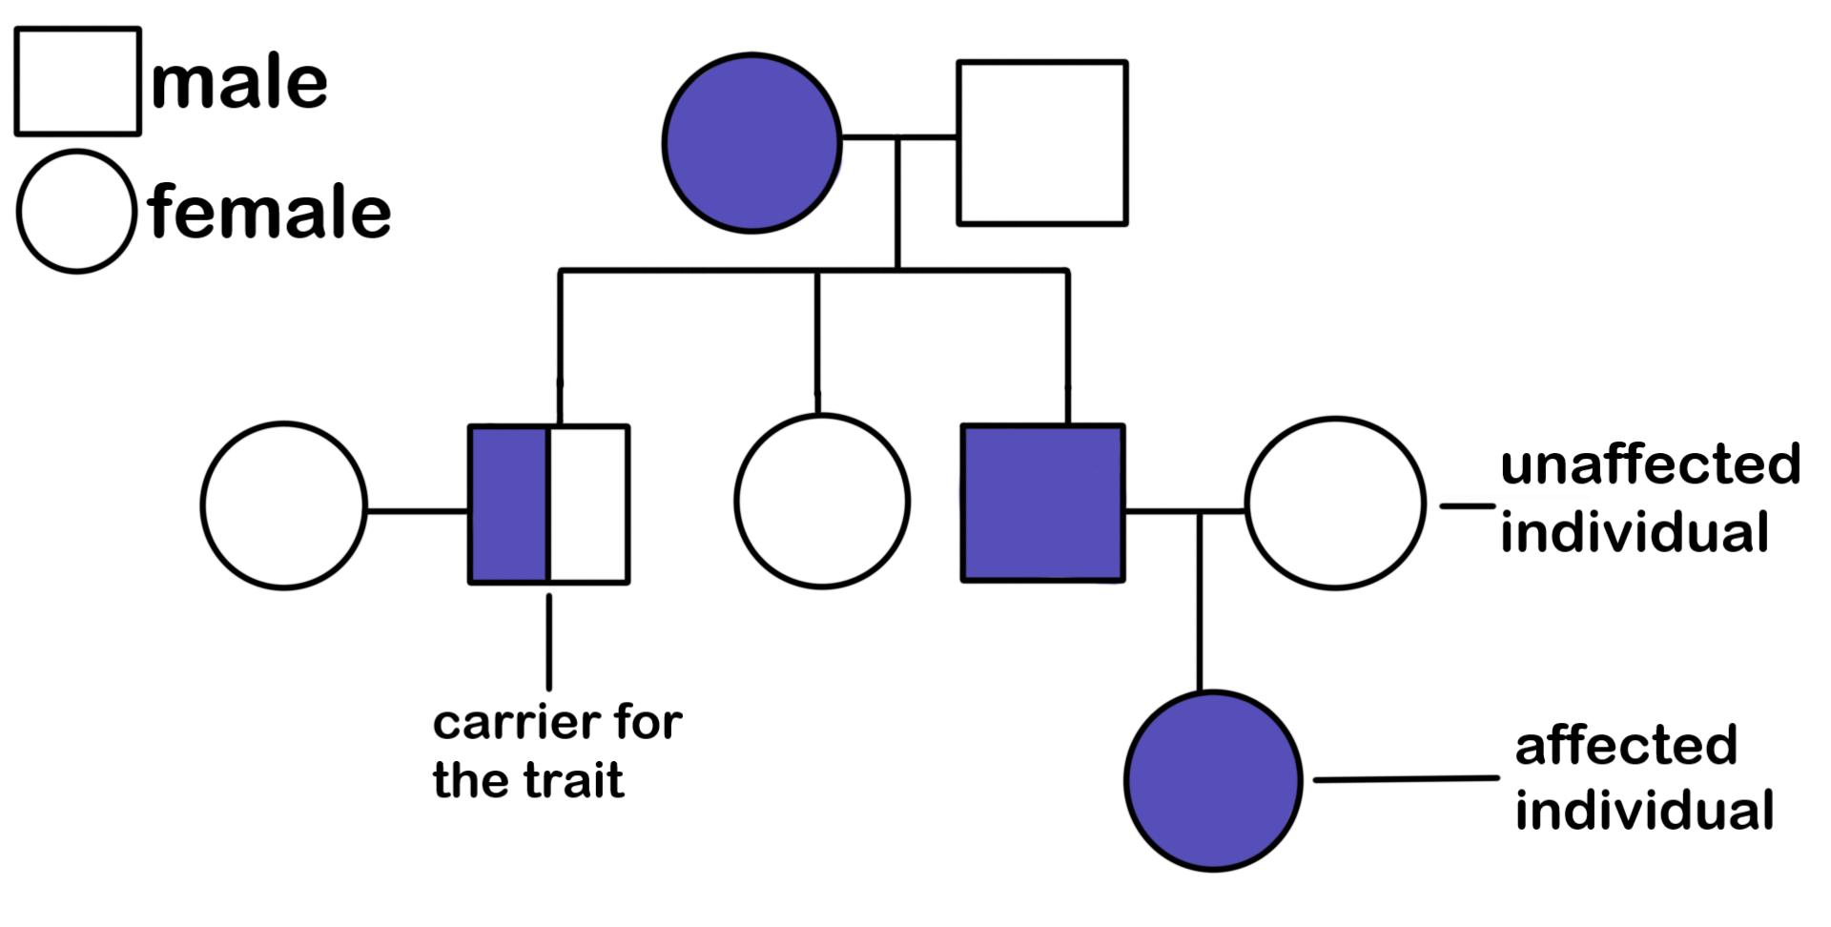

Slide 16
We are learning about how pedigree charts represent sex linked traits
Rules for pedigree charts
A square is used to represent a male
A circle is used to represent a female

Slide 17
We are learning about how pedigree charts represent sex linked traits
2. To show marriage or breeding relationship:
A line is used to connect between a male and female

Slide 18
We are learning about how pedigree charts represent sex linked traits
3. To show the offspring relationships:
A line from the breeding couple (parents)

Slide 19
We are learning about how pedigree charts represent sex linked traits
4. To show carriers of a particular traits
These are represented as shaded boxes

Slide 20
We are learning about how pedigree charts represent sex linked traits
From the pedigree chart to the right
Which are carriers of the trait?
Phillip
Sandra
Sam
Jessica
Dave

Slide 21
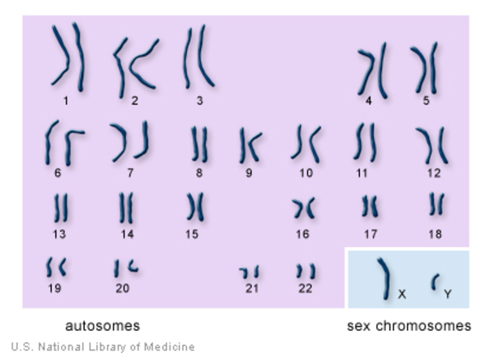
We are learning about how pedigree charts represent sex linked traits
For the punnett squares that we have looked at previously we have only used autosomal chromosomes.
Some traits are carried on the sex chromosome though.

Slide 22
We are learning about how pedigree charts represent sex linked traits
This is called sex linked inheritance
If the gene is on the X chromosome = X linked
If the gene is on the Y chromosome = Y linked

Slide 23
We are learning about how pedigree charts represent sex linked traits
Chromosomes
Males- XY
Females- XX
We describe with a trait that is sex linked as
X^{b}Y
X^{B}X^{b}
^{B} is the dominant trait
^{B} is the recessive trait
X and Y are the chromosomes

Slide 24
We are learning about how pedigree charts represent sex linked traits
Sex linked traits
For a female to inherit a trait they need to inherit 2 of the alleles. Males only have 1 Y chromosome so they only need one of the alleles (passed on from their mother).

Slide 25
We are learning about how pedigree charts represent sex linked traits
Being colour blind is an X linked recessive trait
Phillip- X^{b}Y
Sandra- X^{B}X^{b}
Here both carry the trait (Sandra is not affected)
X^{B} X^{b}
X^{b}
Y
Phillip
Sandra
Sam
Jessica
Dave

Slide 26
We are learning about how pedigree charts represent sex linked traits
Being colour blind is an X linked recessive trait
Phillip- X^{b}Y
Sandra- X^{B}X^{b}
Here both carry the trait (Sandra is not affected)
X^{B} X^{b}
X^{b}
Y
Phillip
Sandra
X^{b}X^{B} | X^{b}X^{b}
X^{B}Y | X^{b}Y
Dave
Sam
Jessica

Slide 27
We are learning about how pedigree charts represent sex linked traits
Being colour blind is an X linked recessive trait
Phillip- X^{b}Y
Sandra- X^{B}X^{b}
1. Which of the boxes has the colour blind trait?
X^{B} X^{b}
X^{b}
Y
Phillip
Sandra
X^{b}X^{B} | X^{b}X^{b}
X^{B}Y | X^{b}Y
Dave
Sam
Jessica

Slide 28
We are learning about how pedigree charts represent sex linked traits
Being colour blind is an X linked recessive trait
Phillip- X^{b}Y
Sandra- X^{B}X^{b}
2. Which of the boxes are male or female?
X^{B} X^{b}
X^{b}
Y
Phillip
Sandra
X^{b}X^{B} | X^{b}X^{b}
X^{B}Y | X^{b}Y
Dave
Sam
Jessica

Slide 29
We are learning about how pedigree charts represent sex linked traits
Being colour blind is an X linked recessive trait
Phillip- X^{b}Y
Sandra- X^{B}X^{b}
3. Based on the pedigree write the X linked trait each child received
X^{B} X^{b}
X^{b}
Y
Phillip
Sandra
X^{b}X^{B} | X^{b}X^{b}
X^{B}Y | X^{b}Y
Dave
Sam
Jessica

Slide 30
We are learning about how pedigree charts represent sex linked traits
TRACK WITH ME
READ WITH ME
I can read pedigree charts to identify affected individuals
I can use punnett squares to predict X linked inheritance

